Slide 1

Experiential Learning Project Assessment-I on
“Simple Stopwatch”
under the course
Python Programming Language (N-PCCCM304P)
Presented By:
Muskan Shah [CM25032]
Under the Guidance of
Mrs. Mayuri Getme
Session:2026-27 (ODD )
Department of CSE(AI&ML)
S. B. JAIN INSTITUTE OF TECHNOLOGY MANAGEMENT AND
RESEARCH,NAGPUR
An Autonomous Institute, Affiliated to RTMNU, Nagpur
)

Slide 2
Contents
Problem statement
Objectives
Algorithm
Flowchart/pseudocode
Understanding of Python logic
GitHub account, repository creation, uploading code, meaningful commits, collaboration, individual contribution
S. B. Jain Institute of Technology Management and research

Slide 3
1. Problem Statement
Measuring elapsed time manually can be inconvenient and inaccurate.
The proposed Simple Stopwatch solves this problem by:
Providing a digital stopwatch through a Python program.
Recording the time when the stopwatch is started.
Calculating elapsed time when the stopwatch is stopped.
Displaying the elapsed time in seconds.
Allowing the user to reset the stopwatch.
Preventing invalid operations.
Preventing the user from starting an already running stopwatch.
Preventing the user from stopping the stopwatch before starting it.

Slide 4
2. Objective
The main objectives of this project are:
To develop a simple stopwatch application using Python.
To understand the use of Python's built-in time module.
To calculate elapsed time accurately using timestamps.
To provide Start, Stop, Display, and Reset operations.
To prevent invalid operations such as stopping before starting.
To prevent multiple starts without stopping or resetting.
To understand conditional statements, loops, functions, and variables in Python.
To create a simple menu-driven Python application.
.

Slide 5
3. Algorithm
Start the program.
Import the time module.
Initialize start_time and elapsed_time.
Display the stopwatch menu.
Ask the user to select an operation.
If the user selects Start:
  Check whether the stopwatch is already running.
  If not running, store the current time.
If the user selects Stop:
  Check whether the stopwatch has been started.
  Calculate the difference between current time and start time.
  Add it to the elapsed time.
If the user selects Display:
  Show the current elapsed time.
If the user selects Reset:
  Set the timer values back to zero.
If the user selects Exit, terminate the program.
Otherwise, display an invalid-choice message.
Stop the program.

Slide 6
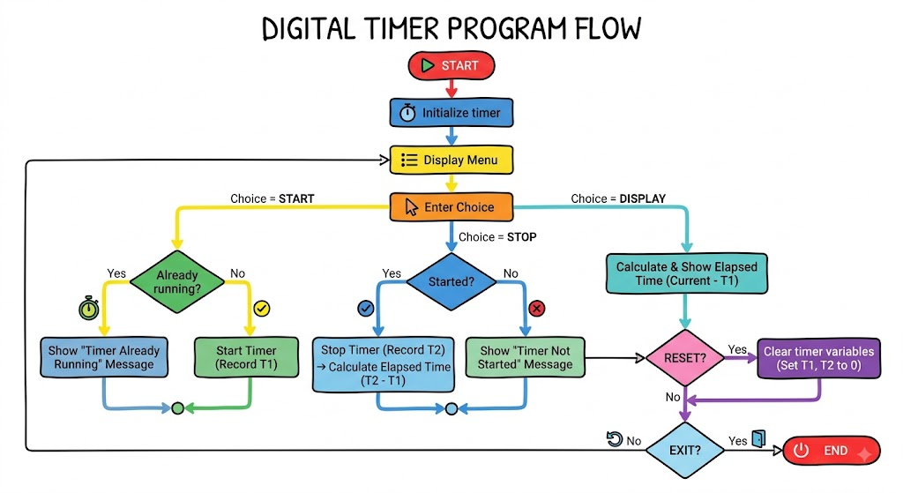
4. Flowchart

Slide 7
5. Understanding of python logic
import time is used to access Python's time functions.
time.time() records the current time.
Variables store the start time, elapsed time, and running status.
if-else conditions check whether the stopwatch can be started or stopped.
Functions are used to perform different stopwatch operations.
A while loop repeatedly displays the menu until the user chooses Exit.
The elapsed time is calculated by finding the difference between the current time and start time.
The reset operation sets all timer values back to their initial state.

Slide 8
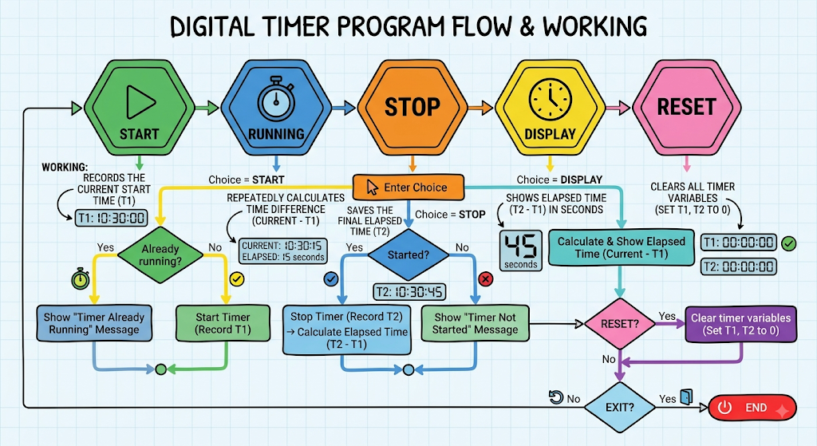
6. Graphical Representation and Working

Slide 9
7. GitHub Account, Repository & Collaboration
Create GitHub Account – Set up a personal GitHub account.
Create Repository – Library Booking System Under Hash Table
Upload Code – Upload the Python project files.
Meaningful Commits – Save changes with clear commit messages.
Collaboration – For teamwork, use repository sharing, branches or pull requests.
Individual Contribution – Each member contributes and commits their work.
Track Changes – Use GitHub to manage and track project updates.

Slide 10
8. Individual Contribution
Problem Analysis – Studied the stopwatch requirements.
Algorithm Design – Designed the stopwatch operations.
Python Coding – Implemented the stopwatch program.
Testing – Tested Start, Stop, Display and Reset.
GitHub Contribution – Uploaded code and made commits.
Documentation & PPT – Prepared project documentation and slides.

Slide 11
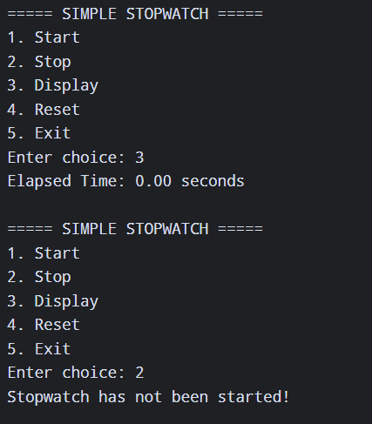
9. Result / Expected Output

Slide 12
Thank You

